Slide 1
Toxic comment classification
Simone Monti – 807994
Vittorio Maggio – 817034
University of Milano-Bicocca

Slide 2

Deep learning approach
https://www.kaggle.com/c/jigsaw-toxic-comment-classification-challenge

Slide 3
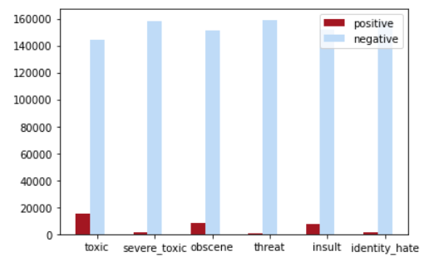
Dataset
Toxic
Severe toxic
Obscene
Threat
Insult
Identity hate
Total: 159571 comments

Slide 4
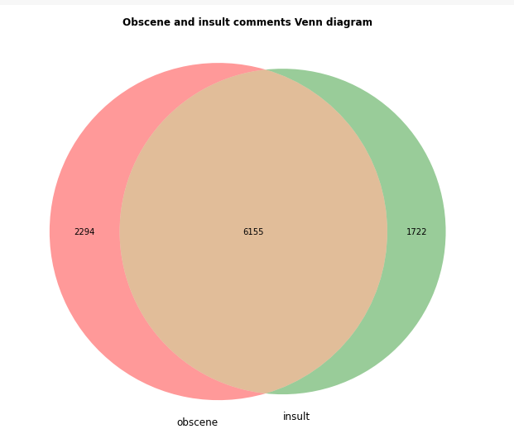
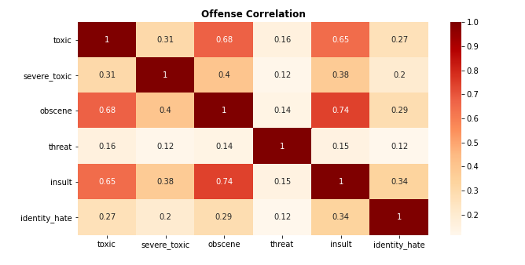
Correlation among categories

Slide 5






Identity hate
Severe toxic
Toxic
Insult
Threat
Obscene

Slide 6
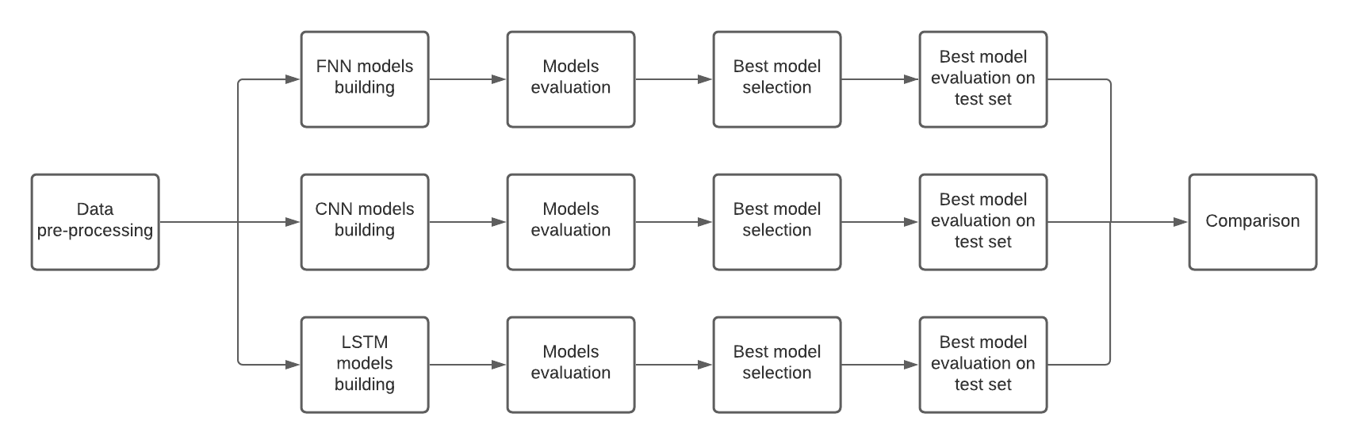
Pipeline

Slide 7
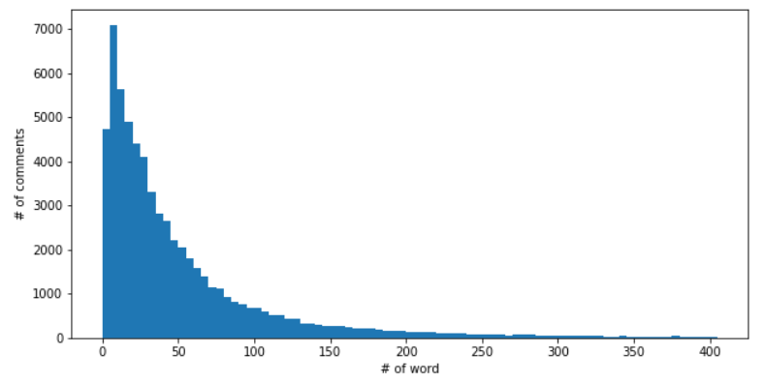
Pre-processing
Text tokenization
Sequence padding
Length: 200

Slide 8
FNN – Architectures
FNN
FNN – additional layer
An Embedding layer (input_dim: 200, output_dim=128),
GlobalMaxPool1D,
a Dense layer formed by X* neurons and with Relu as activation function,
Dropout (rate: 0.3),
a Dense layer formed by 6 neurons with Sigmoid function as activation function (the output is composed by 6 different binary values)
*X = (20 , 30, 40, 50)
An Embedding layer (input_dim: 200, output_dim=128),
GlobalMaxPool1D,
a Dense layer formed by 40 neurons and with Relu as activation function,
Dropout (rate: 0.3),
a Dense layer formed by 20 neurons and with Relu as activation function,
Dropout (rate: 0.3),
a Dense layer formed by 6 neurons with Sigmoid function as activation function (the output is composed by 6 different binary values).

Slide 9
CNN – Architectures
An Embedding layer (input_dim: 200, output_dim=128),
SpatialDropout1D (rate: 0.3),
layer Conv1D with X* filters of dimension 4x1 and Relu as activation function,
BatchNormalization,
GlobalMaxPool1d,
Dropout (rate: 0.3),
a Dense layer formed by 20 neurons and with Relu as activation function,
a Dense layer formed by 6 neurons with Sigmoid function as activation function (the output is composed by 6 different binary values).
* X = (20, 30, 40, 50, 60)

Slide 10
LSTM – Architectures
Bidirectional
Standard
Embedding layer (input_dim: 200, output_dim=128)
SpatialDropout1D (rate: 0.3),
Bi-directional LSTM layer with X* neurons and with Tanh as the activation function, and Sigmoid as recurrent activation,
BatchNormalization,
GlobalMaxPool1d,
Dropout (rate: 0.3),
A Dense layer with 15 neurons and Relu as actiovation function,
a Dense layer formed by 6 neurons with Sigmoid function as activation function (the output is composed by 6 different binary values)
* X = (25, 50)
Embedding layer (input_dim: 200, output_dim=128)
SpatialDropout1D (rate: 0.3),
LSTM layer with 25 neurons with Tanh as activation function, and Sigmoid as recurrent activation,
BatchNormalization,
GlobalMaxPool1d,
layer Dropout (rate: 0.3),
A Dense layer with 15 neurons and Relu as actiovation function,
a Dense layer formed by 6 neurons with Sigmoid function as activation function (the output is composed by 6 different binary values).

Slide 11
Training
Epochs: 10;
Batch size: 256;
Optimizer: Adam (learning rate: 0.01);
Loss: Binary Cross Entropy;
Monitor: validation loss;
Patience: 2;
HyperParametes:
Early Stopping

Slide 12
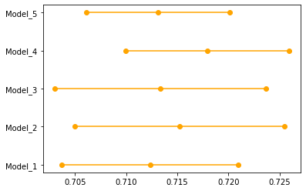
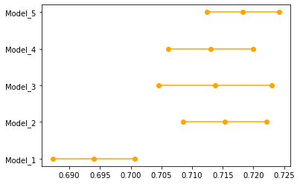
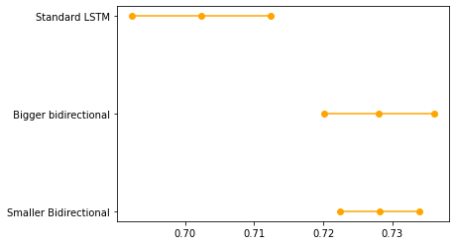
FNN
CNN
RNN
F1 score – validation set
95% confidence interval - 10 folds crossvalidation

Slide 13
Step
The 3 best models selected:
FNN: Model_4
CNN: Model_5
RNN: Smaller bidirectional
Training on the full training set (Train-Val 80%-20%)
Evaluation on the test set

Slide 14
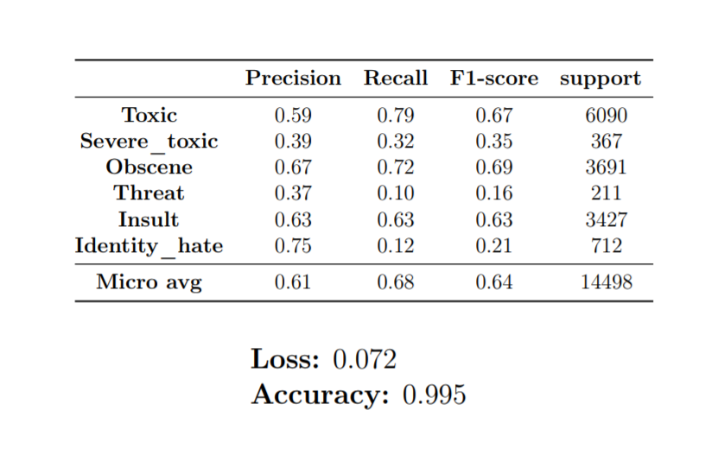
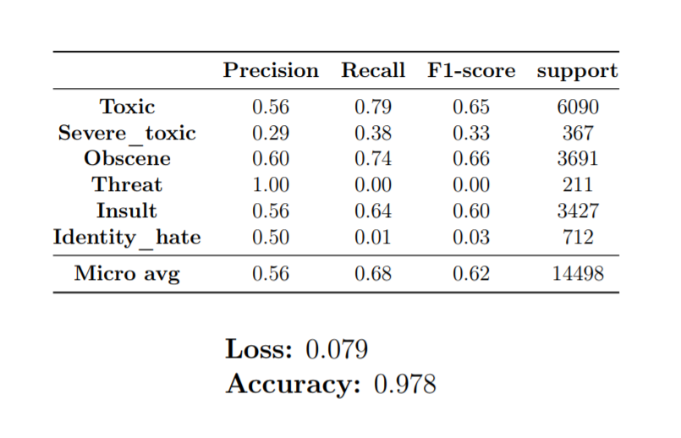
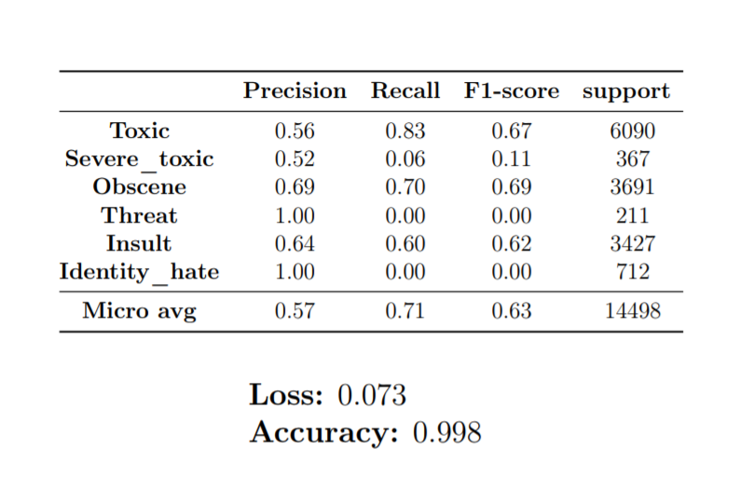
Final comparison
FNN
High accuracy due to high unbalanced dataset
F1 score much lower
No dominance among selected networks
The models are not able to predict categories with few examples in the training
CNN
RNN

Slide 15
Possible future developments
Using of Data Augmentation technique
Using of pre-trained embedding layers such as:
Word2Vec
Glove
BERT

Slide 16

Thank you for your attention
Simone Monti – 807994
Vittorio Maggio – 817034
University of Milano-Bicocca

